Slide 1


AGAINST-REALITY
Roberto, Jadon, Josue, Yvan

Slide 2



Hey Guys.
Welcome to the world of Augmented Reality (AR)

Slide 3

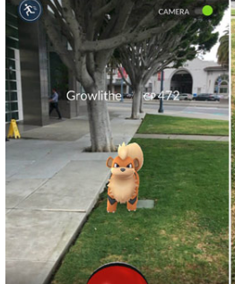
DO YOU USE AR TODAY?
Yes or No?
Where?
WAIT REALLY!?!?!?!? Yes Really (:

Slide 4
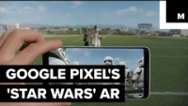

Slide 5
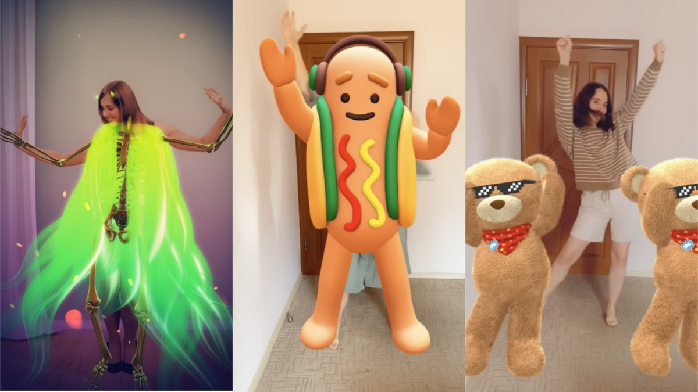
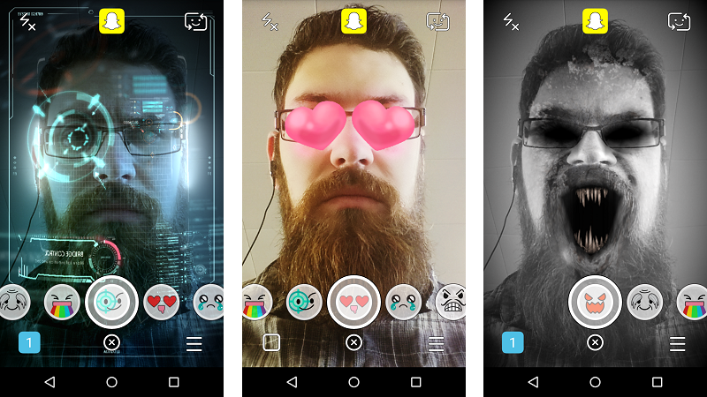
Snapchat
The camera recognizes the human body which then launches a model to follow the body as it moves.
Here the front camera recognizes the eyes, mouth, and outer head to then create an anchor where it can place the objects or visuals.

Slide 6
So what exactly is AR?
AR or Augmented Reality is an enhance real world surroundings overlaying by computers that create digital content such as video, animations, sounds, and graphics. Launched by tech recognizing an object through a camera thus launching an object or visual.
For developers, there are plenty of platforms that they can use in order to perform an AR project. Such as Echo AR and Adobe Aero.

Slide 7
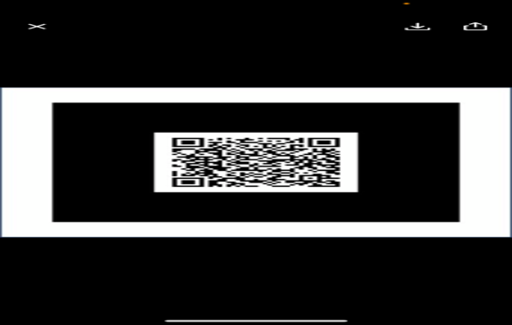
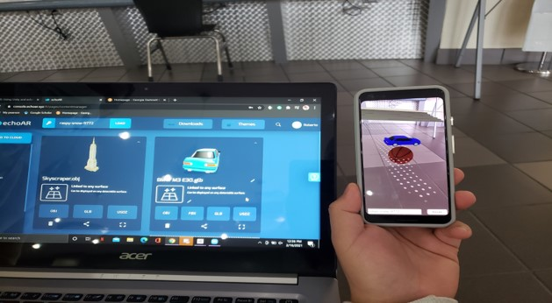
Echo AR
What Tech?
What We Hope and Our Vision
iPad and Tablets
We decided as a group to stick with echoAR it works well with both Apple and android products.
Online or Face-To-Face
Understanding of AR with visual presentations and examples
Will have online examples of AR with echo that pops up designs already created by us for the students.
Echo AR is a platform where you can generate digital objects through your phone.
Our vision is to get everyone excited about our AR technology and understanding the benefits in many fields including marketing, education, and medical fields.

Slide 8
Tutorials
Here are the links to our examples:

Slide 9

Please follow this link on your phones:
https://go.echoar.xyz/dKgq or if you want to see it on the app(echoAR Go) we can use this Key Code lingering-poetry-6509 or Scan the image to the right.
From there you should be able to interact with the image.

Slide 10
Unity
What Tech?
What We Hope and Our Vision
Android and iPad
Unity provides users with manual editing, the shape color, and the movement.
Unity is a cross-platform that can be used to create mobile games in 2D or 3D.
Unity is also a platform where you can type in your game scene in order to get your item to interact in a specific demand. You can use Unity to type in codes for another platform like Echo AR.

Slide 11

Thank you, guys.

Slide 12
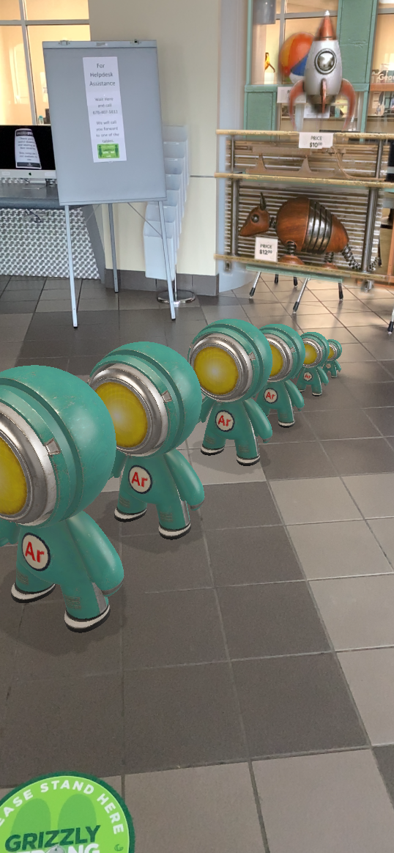
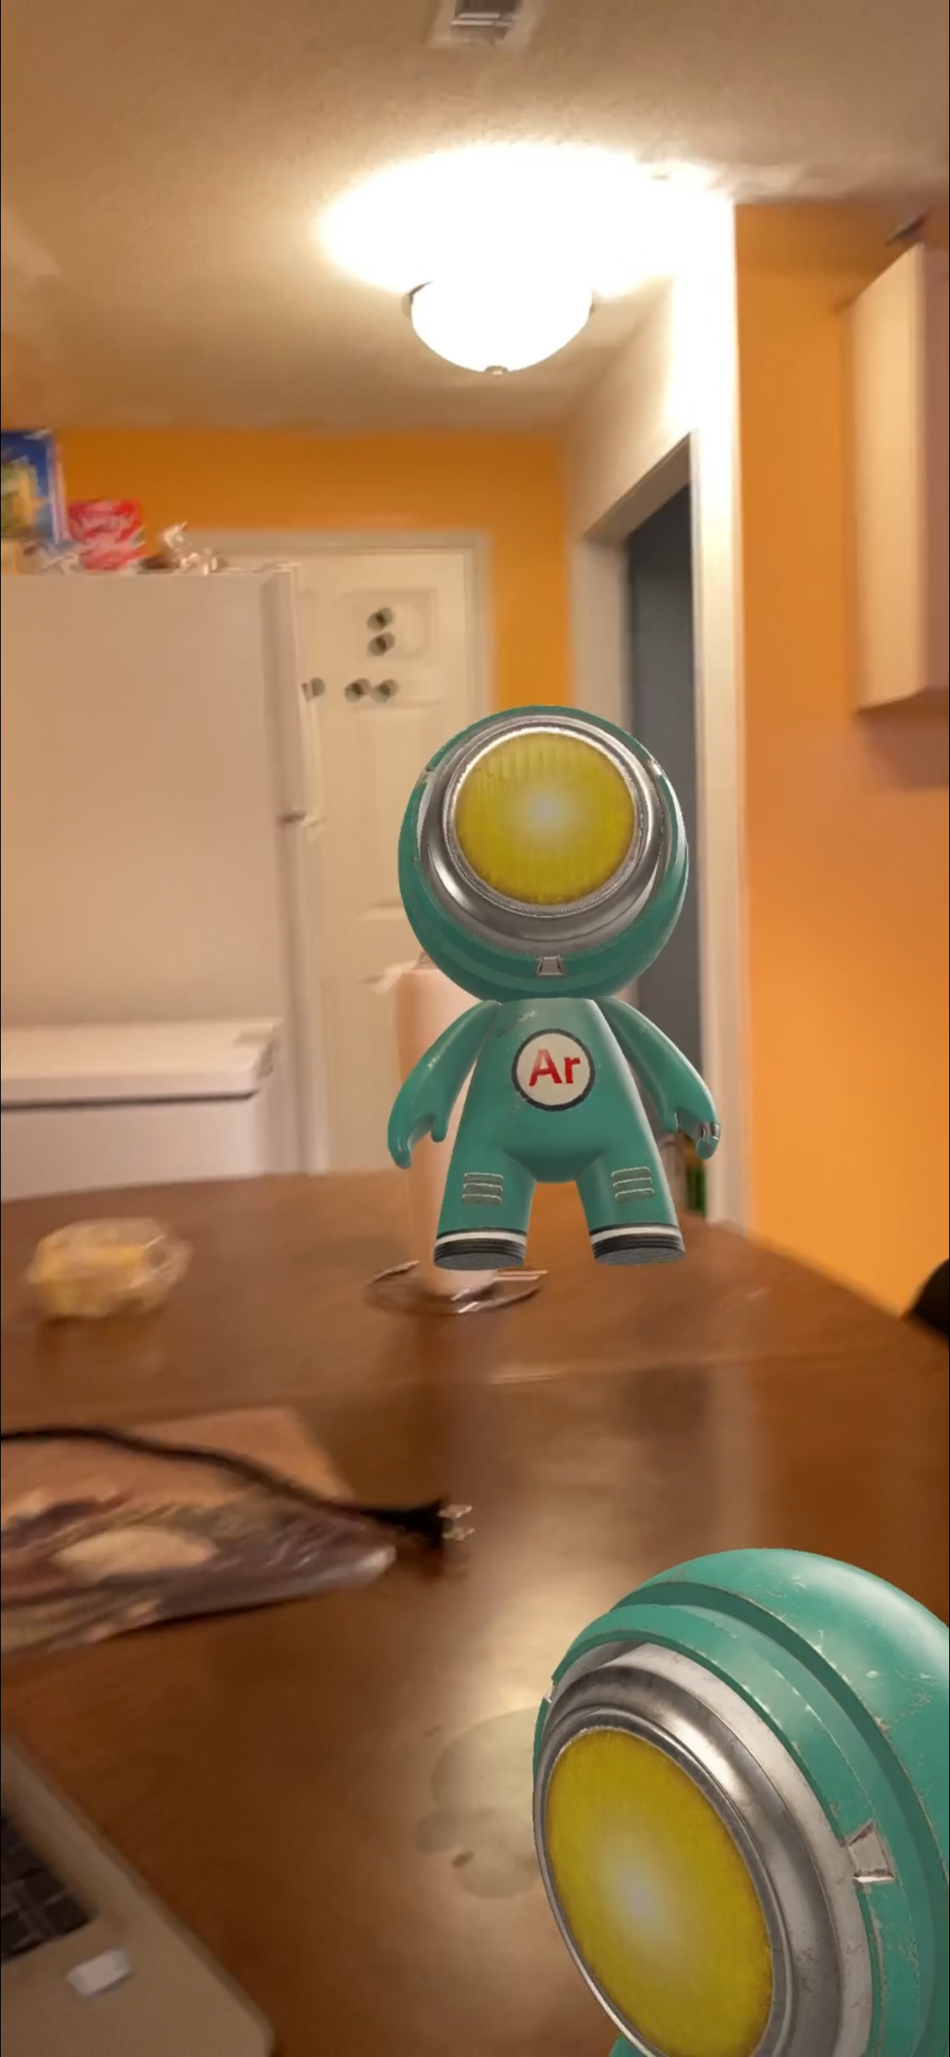
Adobe Aero
What Tech?
What We Hope and Our Vision
iPad
Face to face reality
Picture and video recording of your work.
Aero is also a platform where you can generate digital items through your tech
Our vision is to build environments and characters to would act in our desire demands.
It has helped artists visualize a piece of art into a new three-dimensional form rather than something like sculpting.

